Slide 1
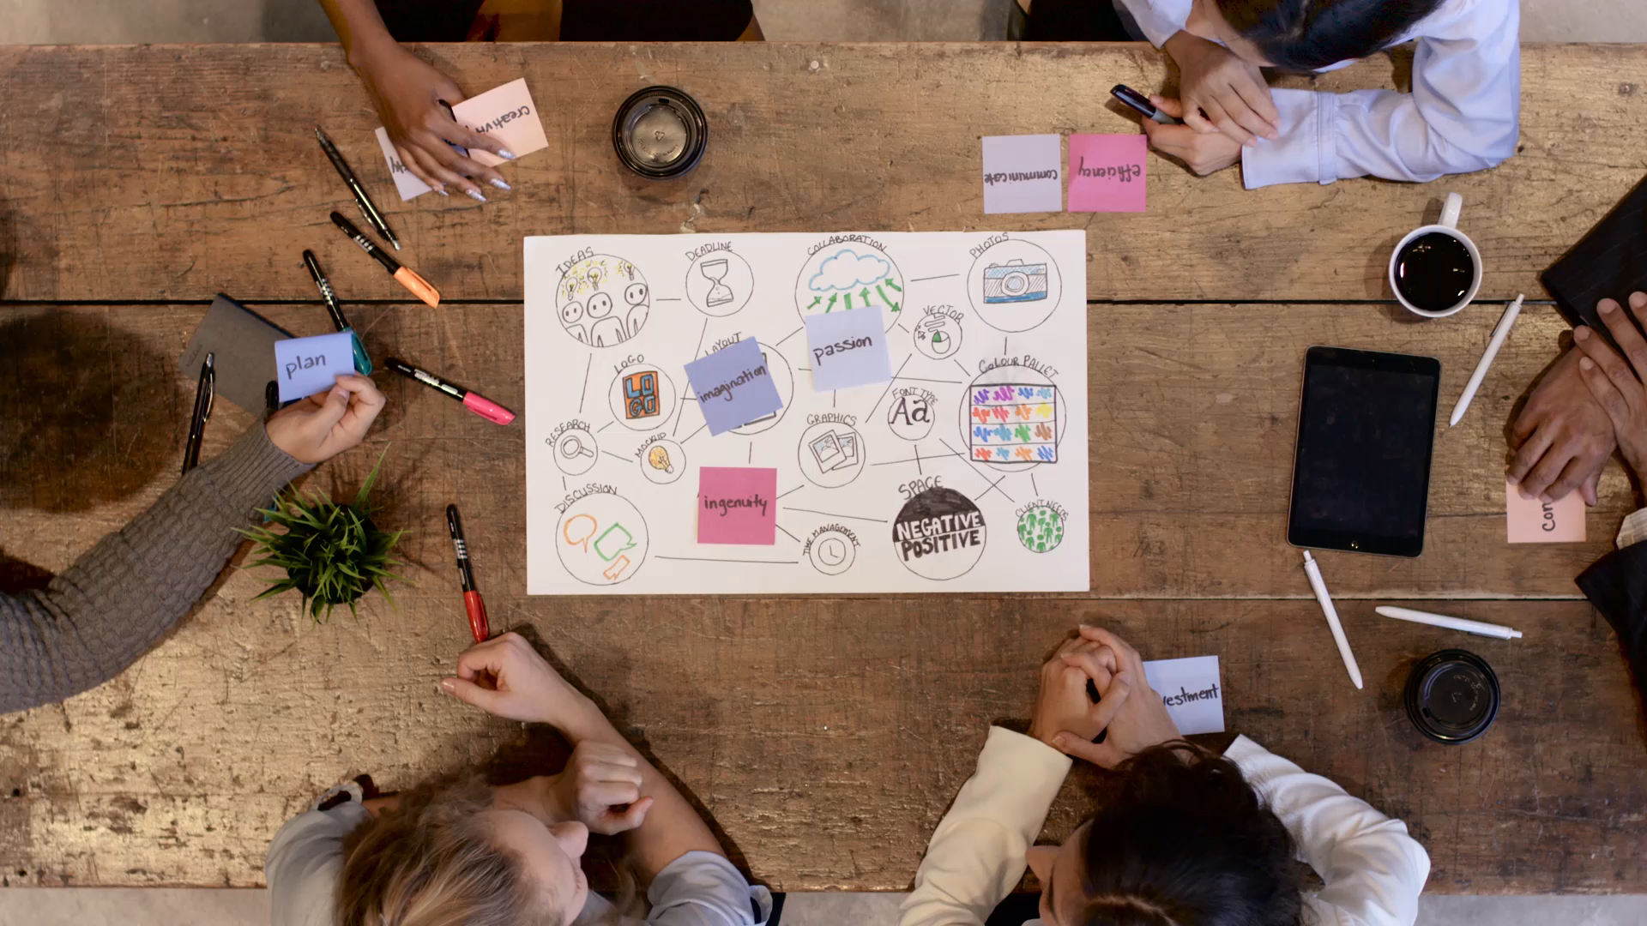

ePortfolios – the past, the present and the future of skills development in higher education.
Dr Cressida Lyon (cl2255@bath.ac.uk)
University of Bath
Dept of Life Sciences

Slide 2
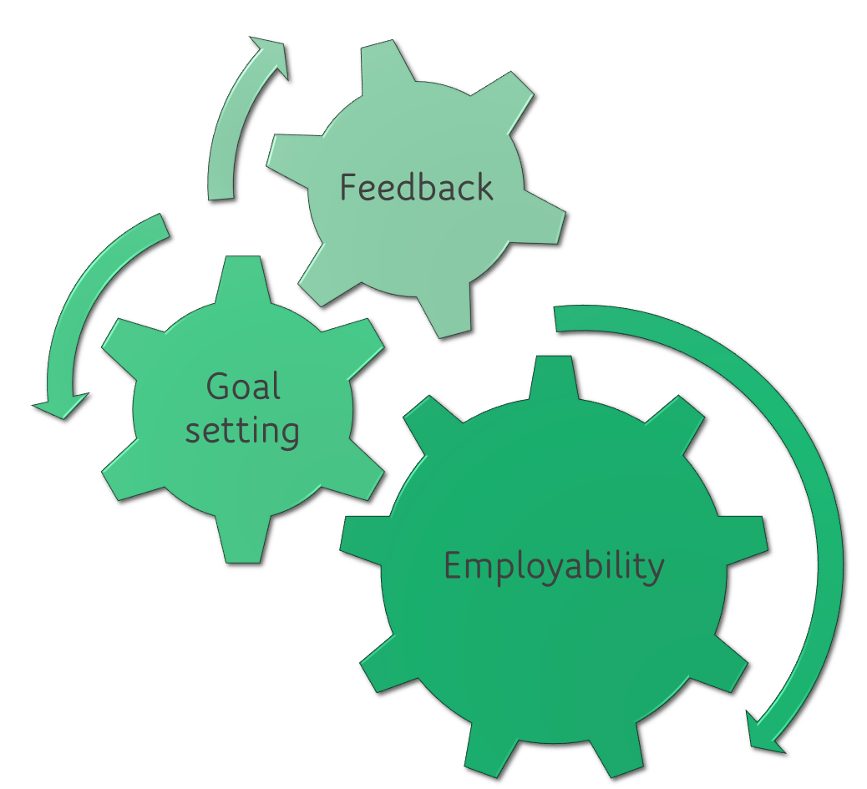
Skills ePortfolio

Slide 3

Why Feedback?
Feedback plays a key role in student learning and achievement
  (e.g. Hattie and Timperley, 2007)
Students are less satisfied with (assessment and) feedback than any other aspect of higher education
  (e.g. National Student Survey (NSS), Student Academic Experience Survey (SAES))

Slide 4

Why employability skills?
Graduate employment used as a metric for quality of university provision
Teaching Excellence Framework (TEF) emphasises importance of employability skills
Stakeholders: HEIs, student, government and employer in the UK
Embed employability skills into curriculum
→ students don’t all realise that they have these skills!

Slide 5

What is an ePortfolio?
Defined as a “purposeful aggregation of digital items [related to learning] which ‘presents’ a selected audience with evidence of a person’s learning and/or ability” (Sutherland and Powell, 2007).
Unique opportunity for:
  Reflection
  Self-monitoring
  Creative expression of understanding and success
  Developing a supportive learning community
  Logging and monitoring skills development during an undergraduate degree
  Demonstrating graduate capabilities
  (JISC, 2019)
Notes:
Sutherland and Powell, 2007. CETIS Portfolio [Online]. Available from: https://www.jiscmail.ac.uk/cgi-bin/WA-JISC.exe?A0=CETIS-PORTFOLIO.
JISC, 2019. How to enhance student learning, progression and employability with e-portfolios [Online]. Available from: https://www.jisc.ac.uk/guides/e-portfolios

Slide 6
Skills ePortfolio
Log feedback, employability and lab skills
Find patterns and gaps
Identify skills to improve
Links to resources

Slide 7



ePortfolio Software

Slide 8
OneNote vs Mahara
Onenote class notebook
mahara
Familiar interface (Microsoft)
Can use content library to share template pages
Can link to and embed documents into your notes
Can add colour coding and images
Easy to share with lecturer
Can add content on nearly any device
Built in accessibility software
Associated Teams page for questions / links
Interface is less familiar (takes time to learn)
Can create and share template pages
Can’t link to or embed documents
Can’t add colour coding and images
Can share with lecturer (had to provide instructions)

Slide 9
Online self paced training module (Year 1)
What is an ePortfolio?
How to set up the ePortfolio
What skills are important to succeed at University?
Setting goals
Feedback: what is it? Feedback as a tool for learning. Logging feedback
Employability skills: what are they? How to demonstrate evidence of employability skills
Online training module (Xerte)

Slide 10

Feedback
Enables students to use feedback more effectively
Based on Advance HE’s Developing Engagement with Feedback Toolkit

Slide 11
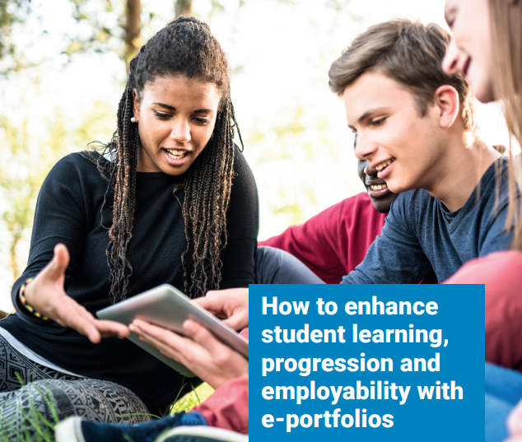

Employability
Based on ideas from JISC Guide: “How to enhance student learning, progression and employability with e-portfolios” (JISC, 2019)
And advice from University of Bath Careers Service

Slide 12

ePortfolio – a tour
ePortfolio master copy (Web view)
If you would like access to view the ePortfolio, email me

Slide 13
How did it go? Start of semester 2…
55% of students had not logged any feedback
Why not?
n=119 students
Thematic analysis of open comments from 98 students

Slide 14
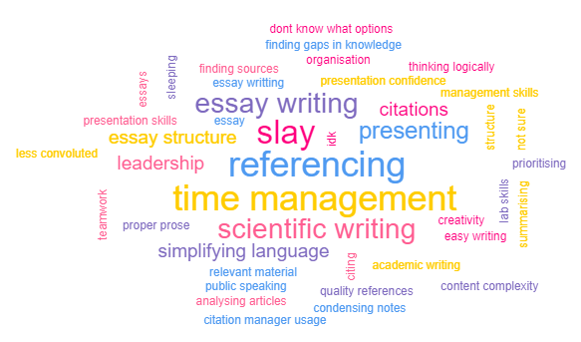
But … they identified skills that they needed to develop
n=32 students

Slide 15
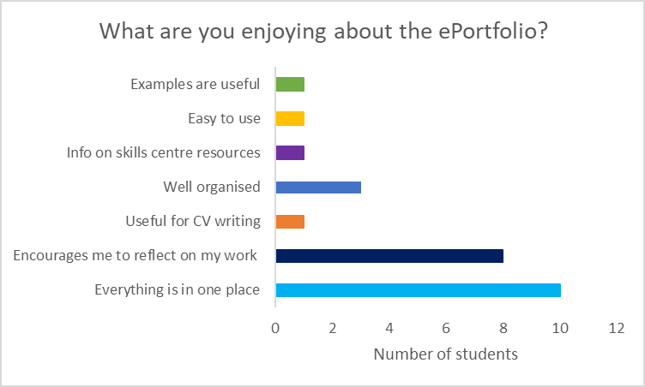
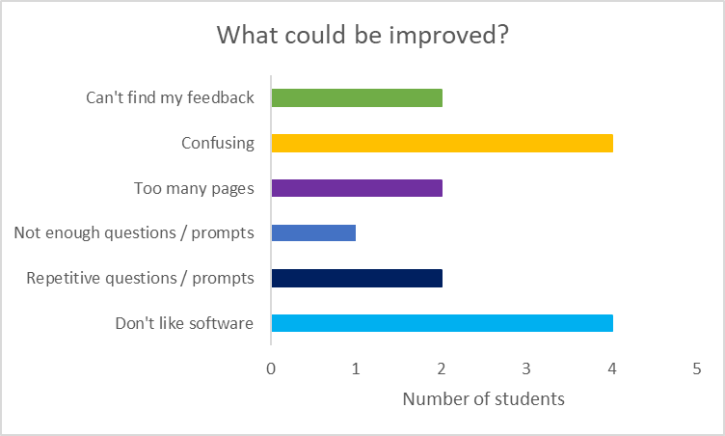
What’s good? What’s bad?
Thematic analysis of open comments from 38 students

Slide 16

What next?
Student researchers to help evaluate the ePortfolio (and make improvements)
Marking and analysis of ePortfolios and placements CVs
Extend to other departments / institutions
If you would like to use the Feedback and Employability Skills ePortfolio with your students, get in touch! cl2255@bath.ac.uk

